Slide 1
“THE HOSTS” RESEARCH AGENCY
WHERE TO INVEST IN ORDER TO BE A HOST IN CDMX?

Slide 2
Research Question
Considering the public available dataset of Airbnb of CDMX:
Which is the best county to become an Airbnb host?

Slide 3
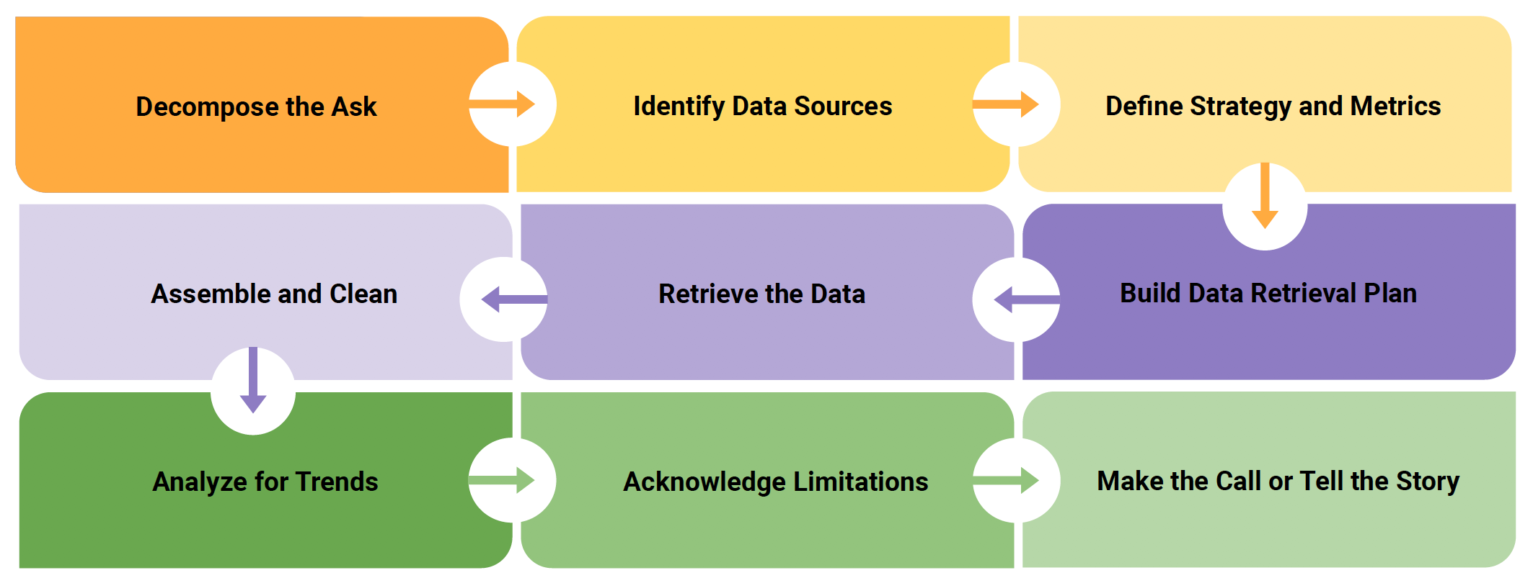
Analytics Paradigm

Slide 4
Step 1: Decompose the “Ask”
Questions.
Is there a relation between amount of properties and location?
Is there a relation between price and location?
Is there a relation between reviews/scores and location?
Is there a relation between room type and location?
Assumptions
The information is accurate.
The reviews are considered as objective.
The input dataset is updated.

Slide 5
Step 1: Decompose the “Ask”
Which metrics use to answer the ASK?
Location
Average price per night
Amount of offer / Airbnb announcements
Number of properties
Type of property (room type)

Slide 6
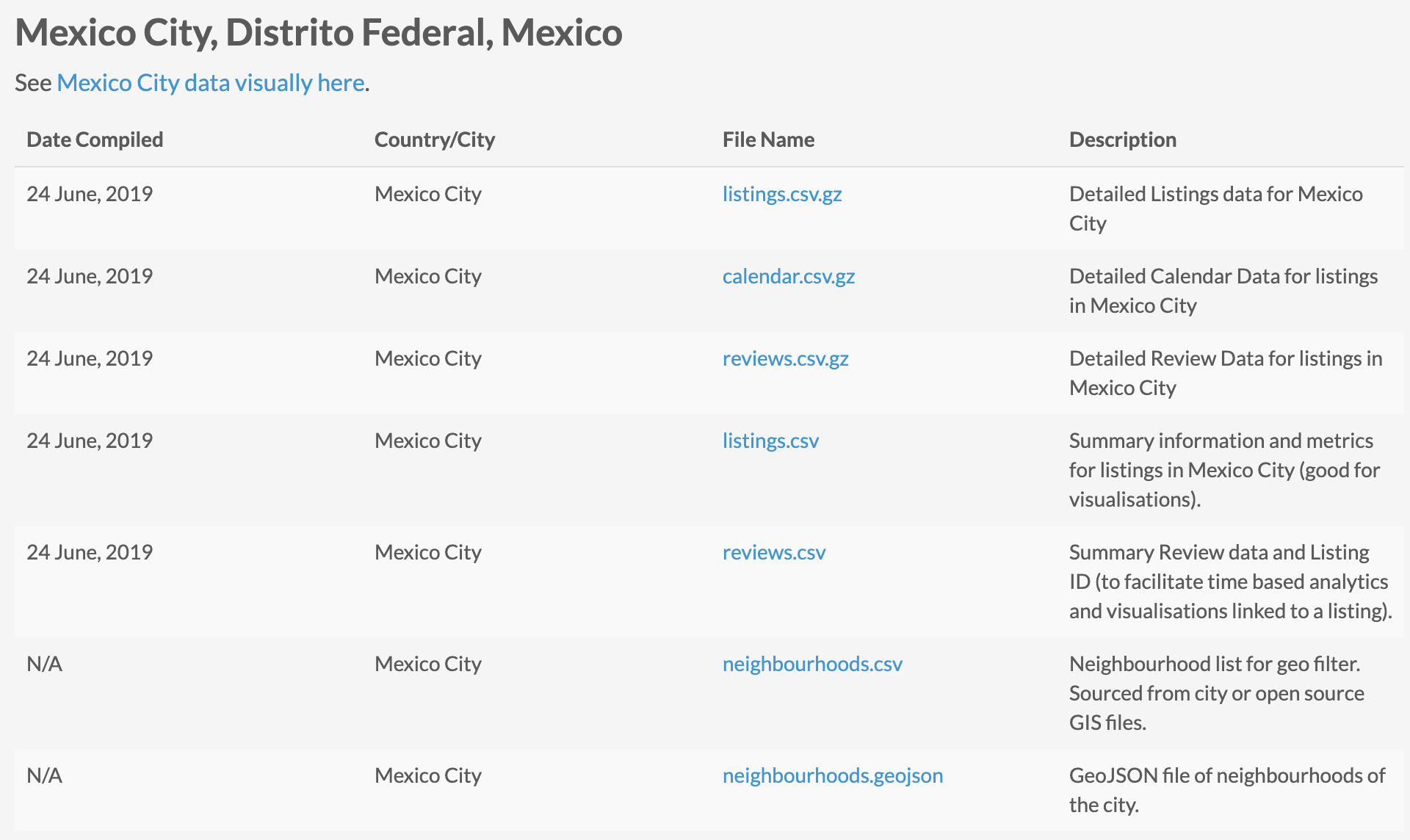
Step 2: Identify Data Sources
Airbnb dataset
API geo location
Location
Price per night
Reviews
Scores
Room type

Slide 7
Step 3: Define Strategy and Metrics
Locations:
Neighbourhoods of each announcement.
Defined by latitude and longitude.
Reviews:
Monthly reviews.
Scores:
Review score ratings.
Rooms:
Room type.
Price:
Price per night MXN.

Slide 8
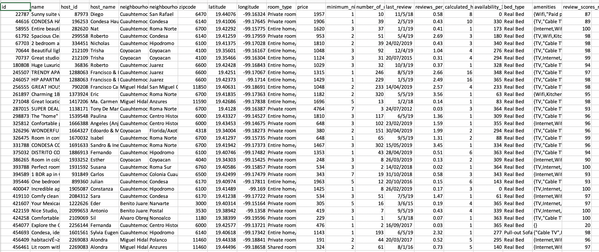
Step 4: Build Data Retrieval Plan
Higher prices per night and null values were not taken into account in the analysis, so 10 counties remained.

Slide 9
Step 5: Retrieve the Data
Step 6: Assemble and Clean the Data
Step 7: Analyze for Trends

Slide 10
Relation between amount of properties and location

Slide 11
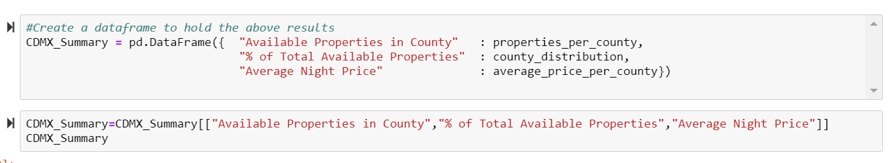
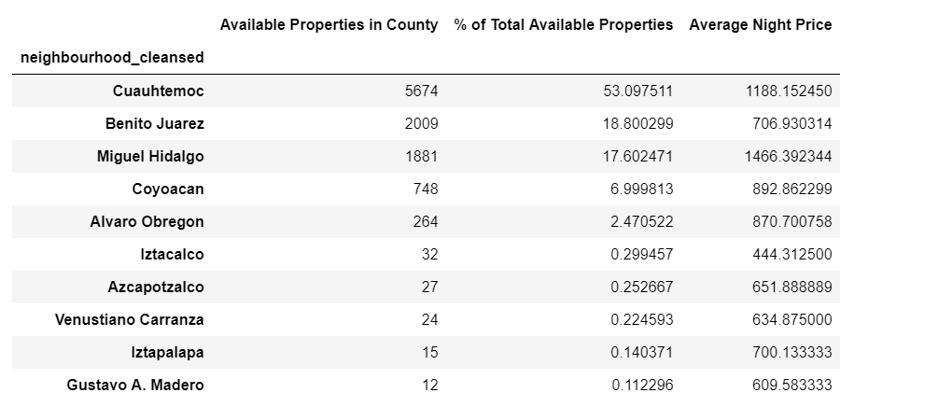
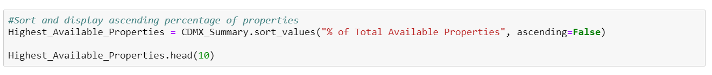
Distribution of properties per county

Slide 12
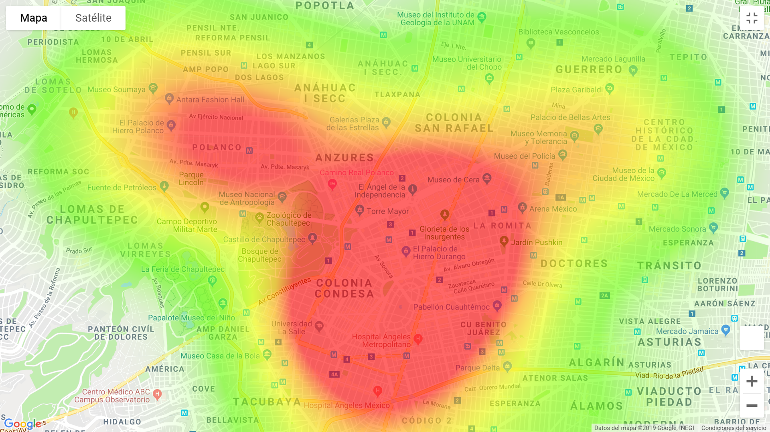
Heat map of properties in CDMX (weight = Price)

Slide 13
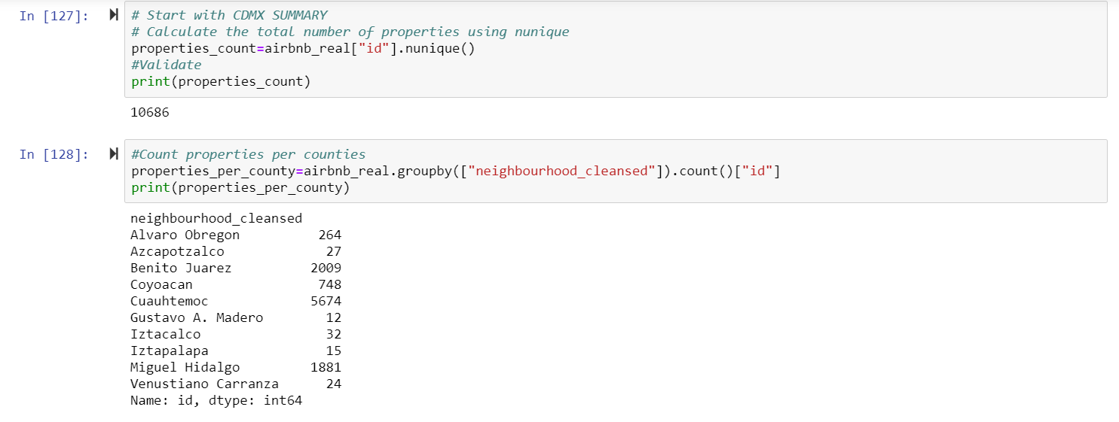
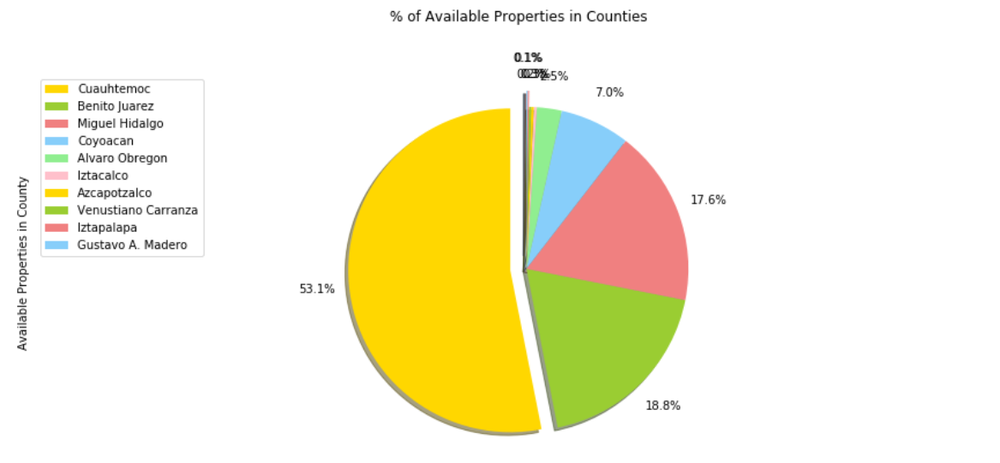
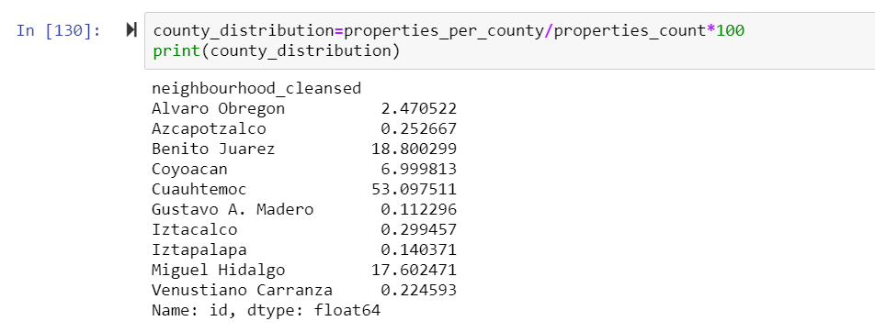
Distribution of properties per county

Slide 14
Relation between price and location

Slide 15
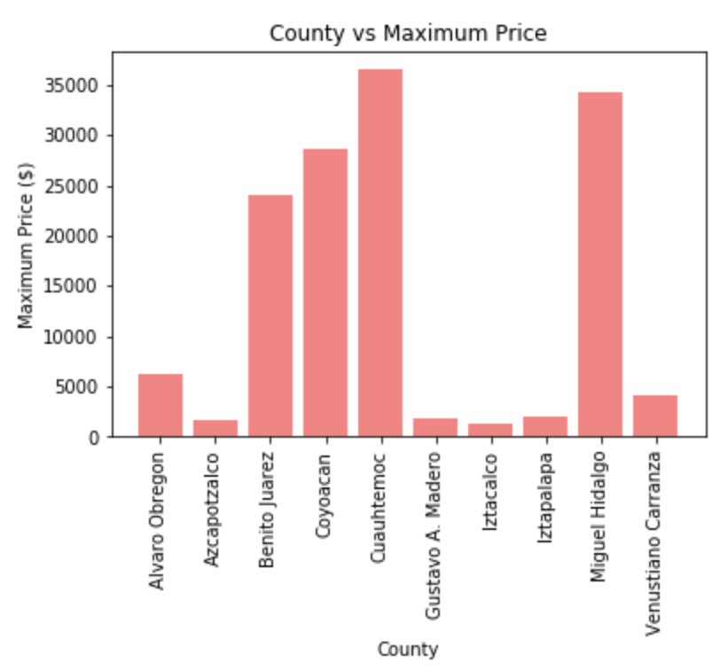
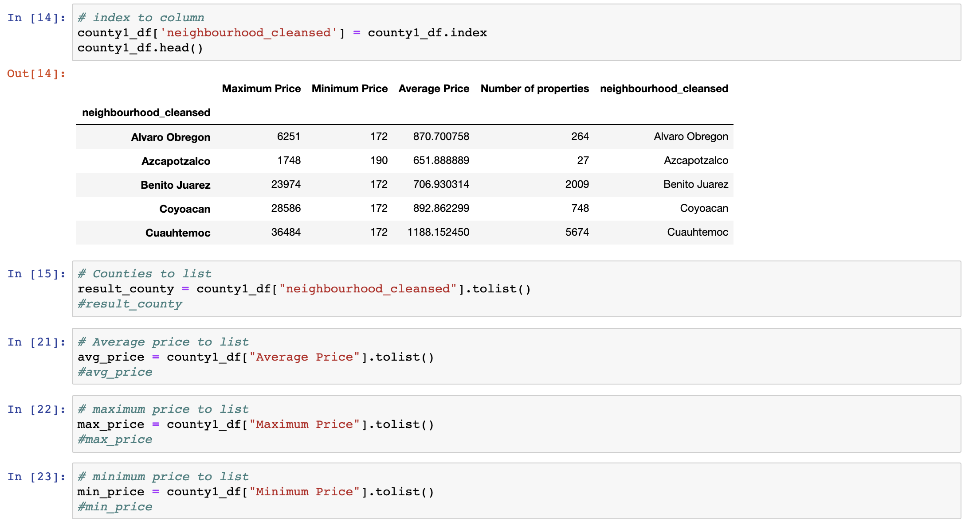
Maximum price per county

Slide 16
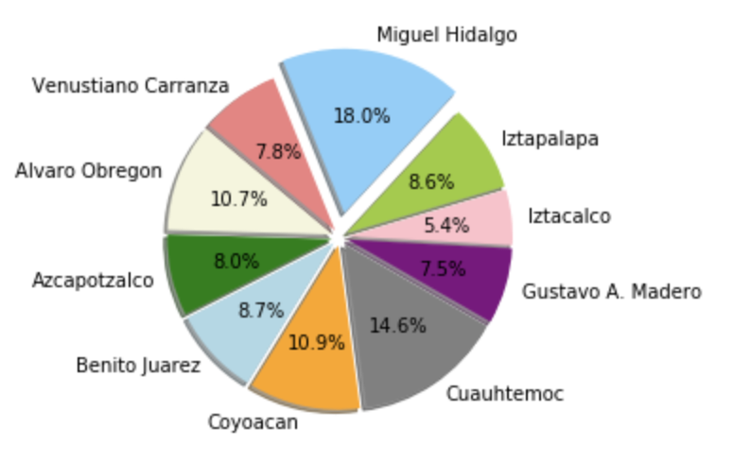
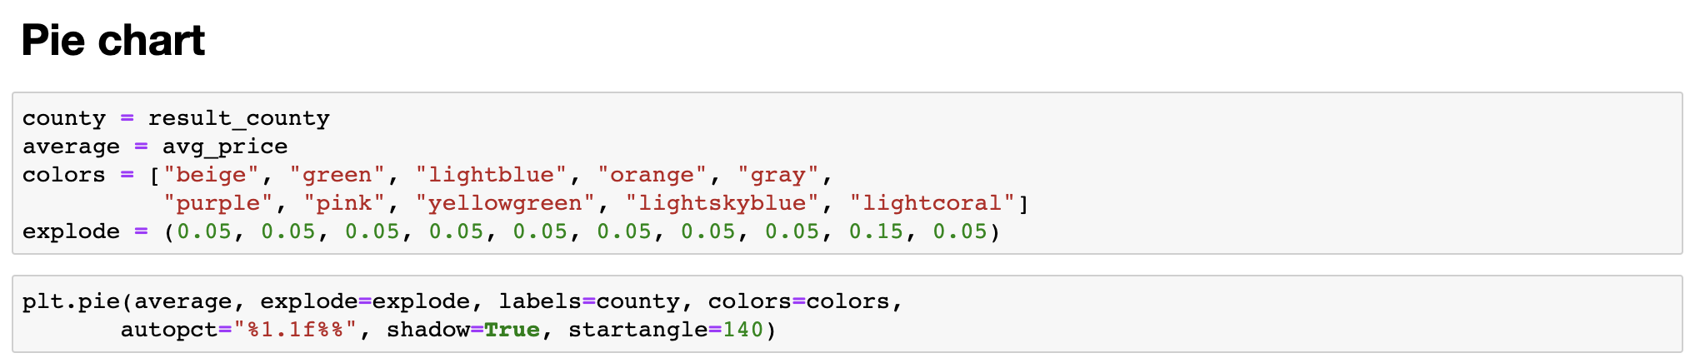
Average price per county

Slide 17
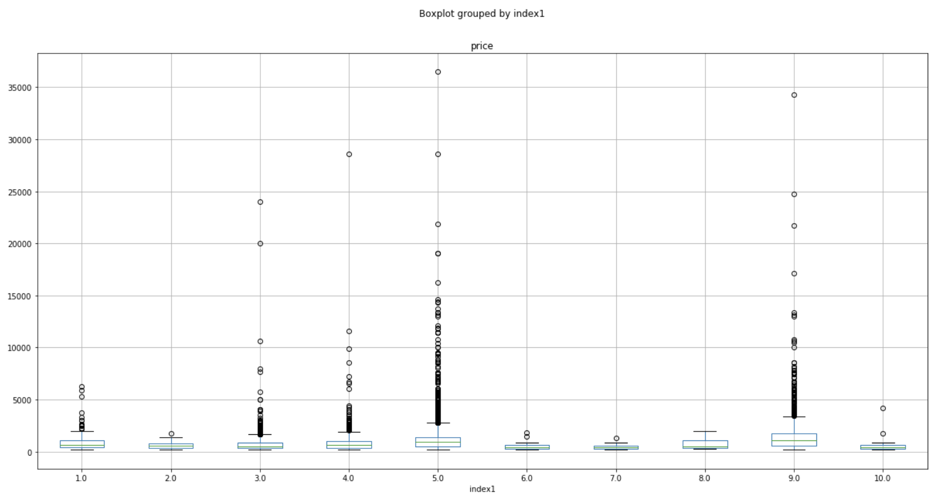
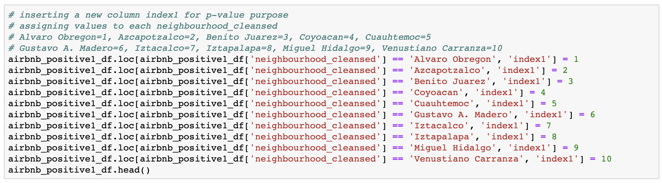
Price per county p-value
F_onewayResult(statistic=1.9361317311939898, pvalue=0.16515928290108603)

Slide 18
Relation between reviews/scores and location

Slide 19
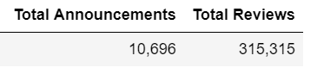
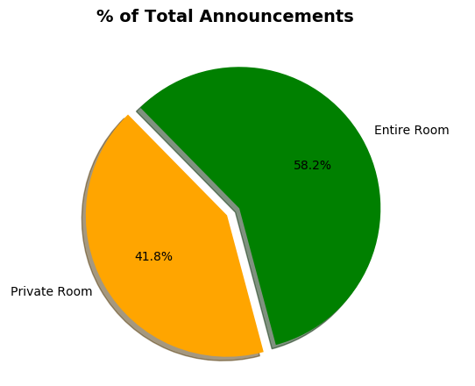
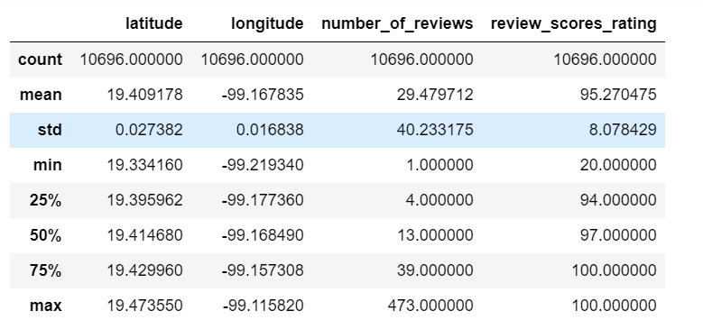

Slide 20
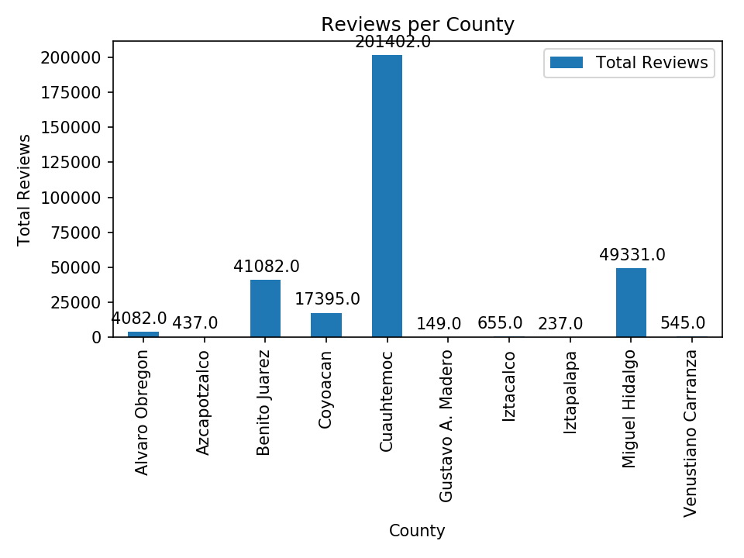
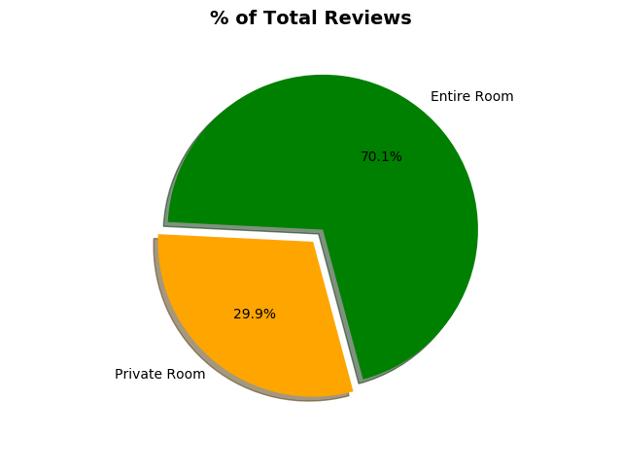

Slide 21
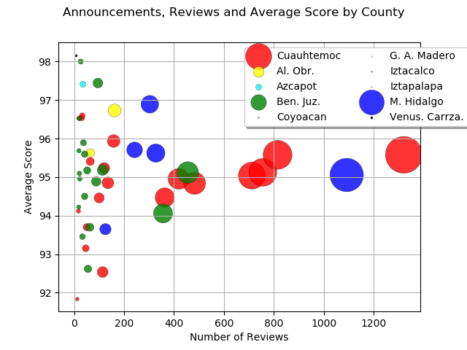
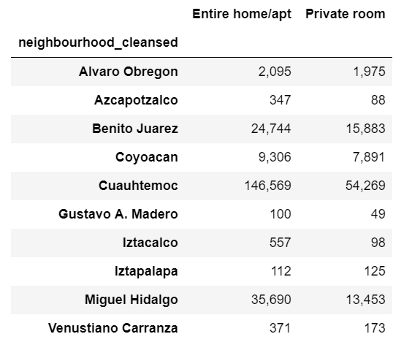

Slide 22
Relation between room type and location

Slide 23
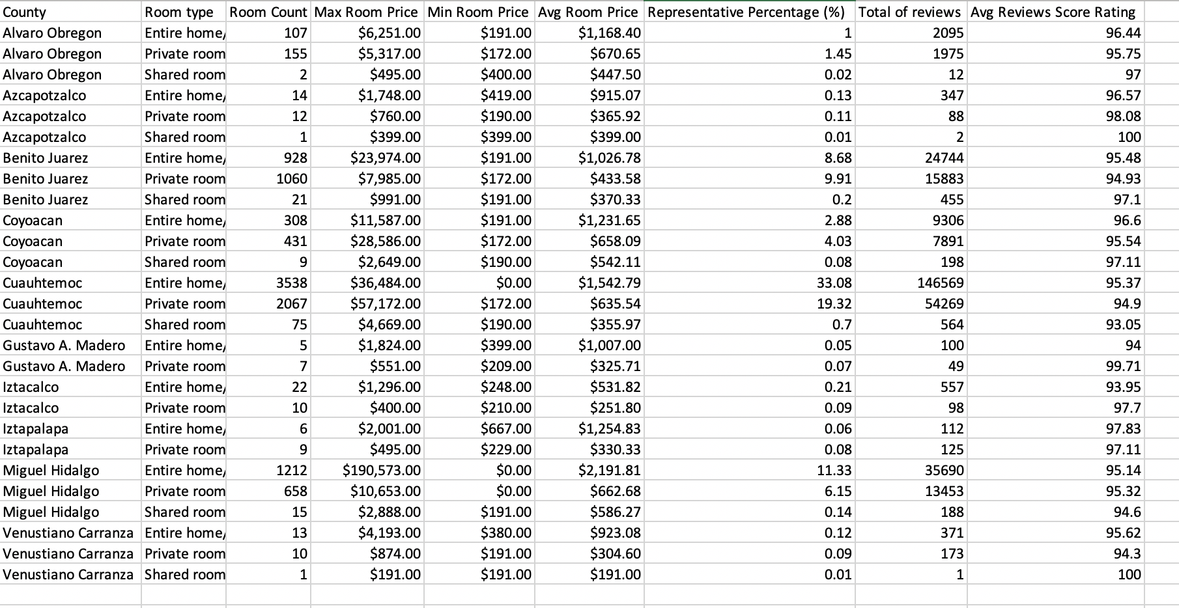
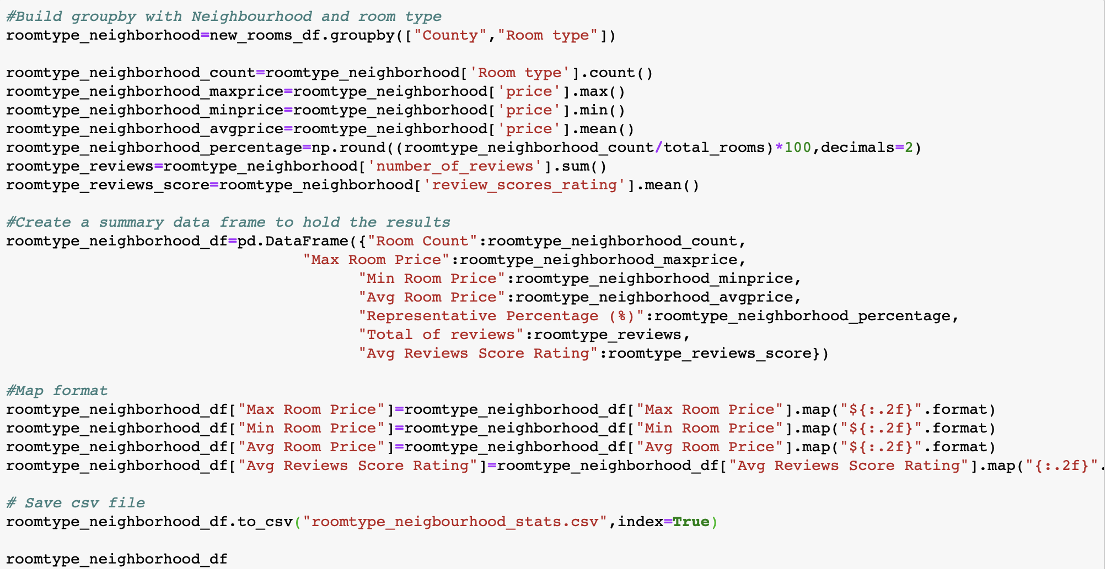
Analyze Room Type Vs Location
Room Type stats by Locations

Slide 24
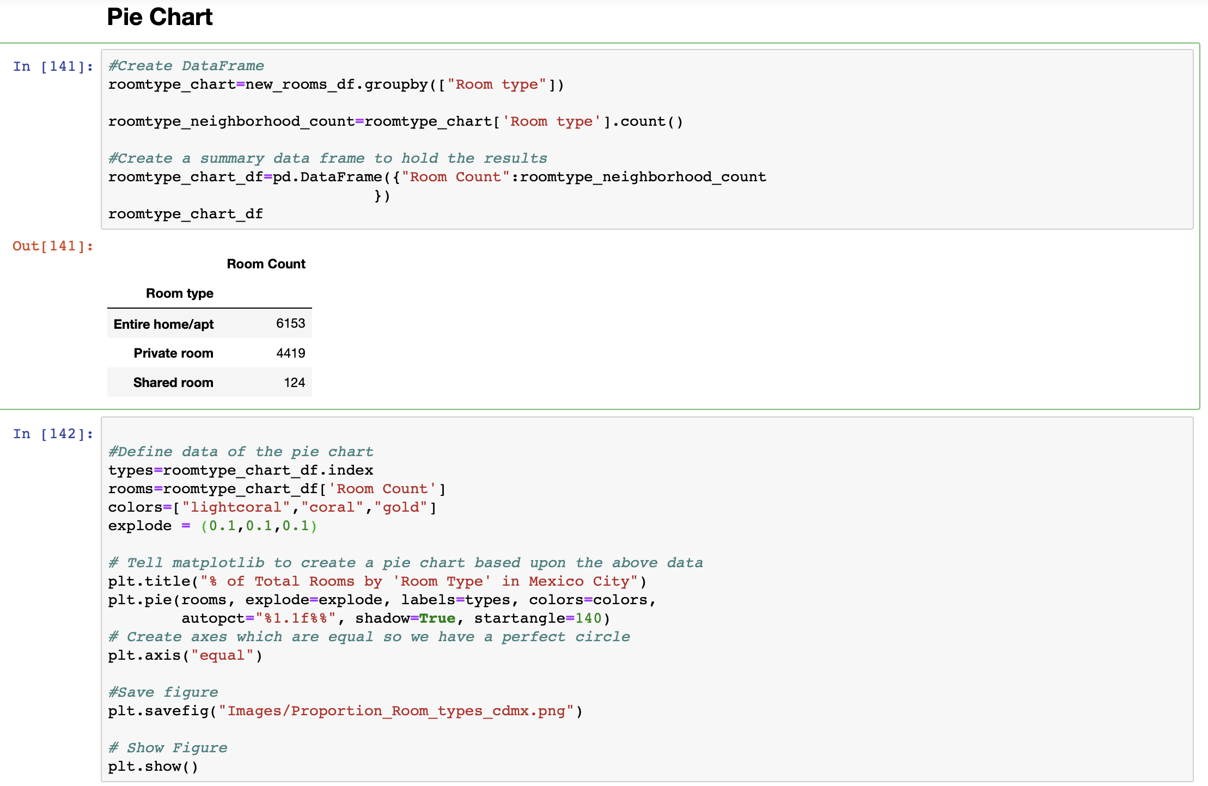
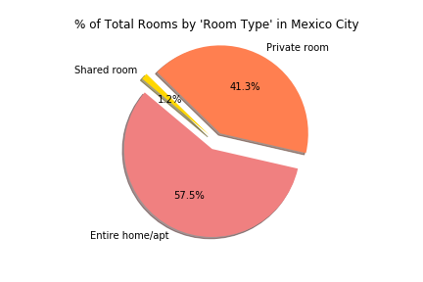
Analyze Room Type Vs Location
Proportion of Room Types in Mexico City:

Slide 25
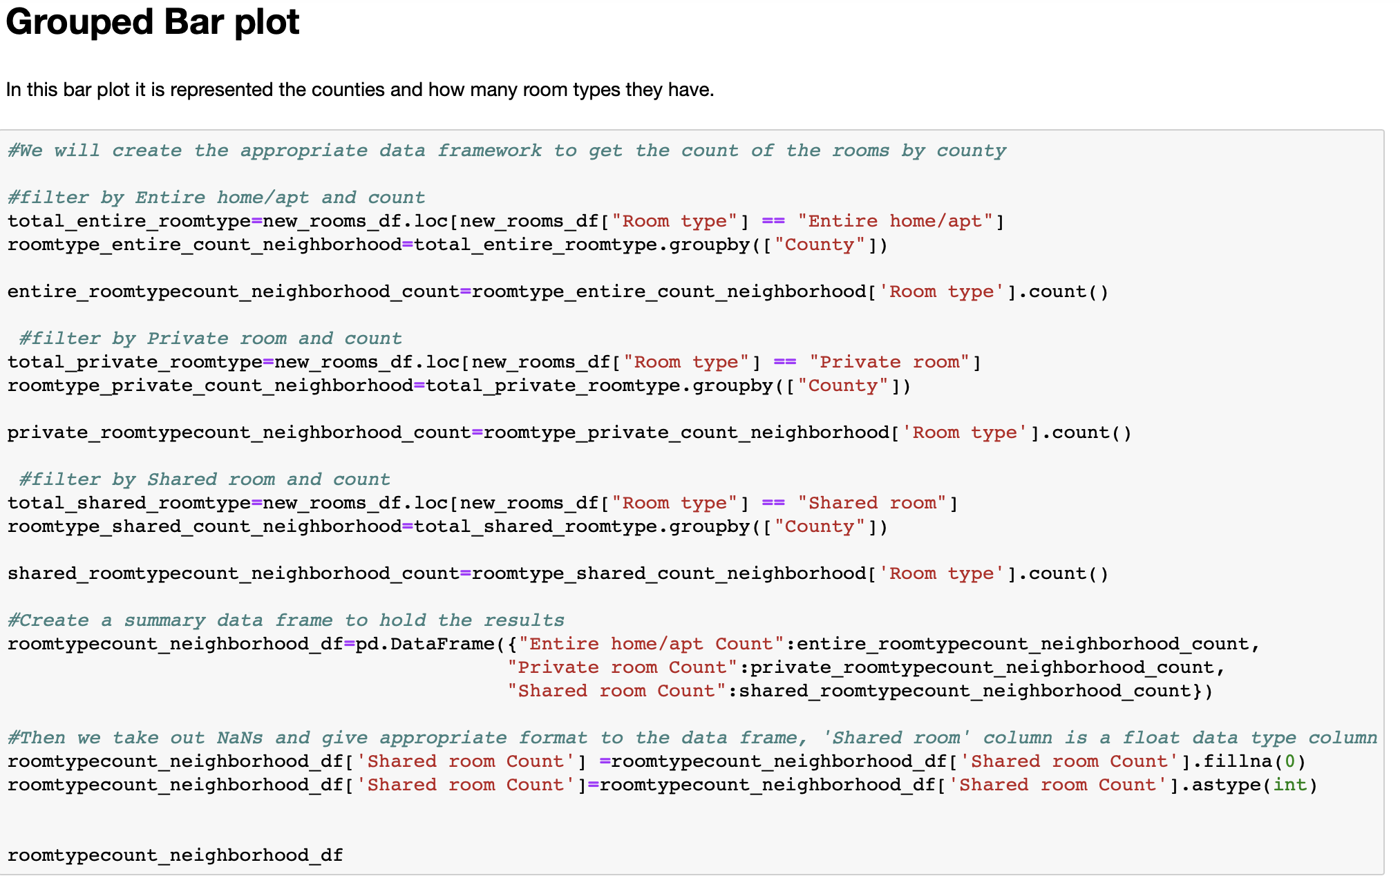
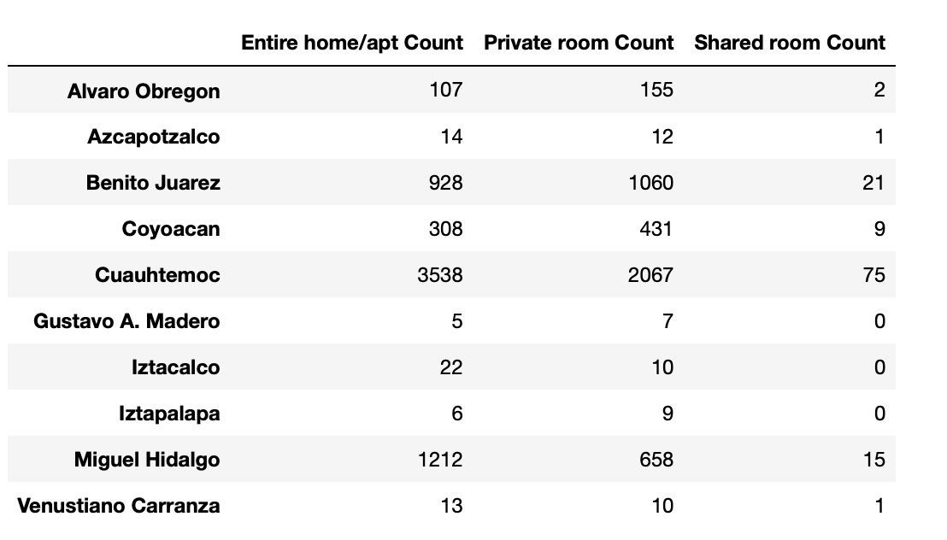
Analyze Room Type Vs Location
Room Type count by Location:

Slide 26
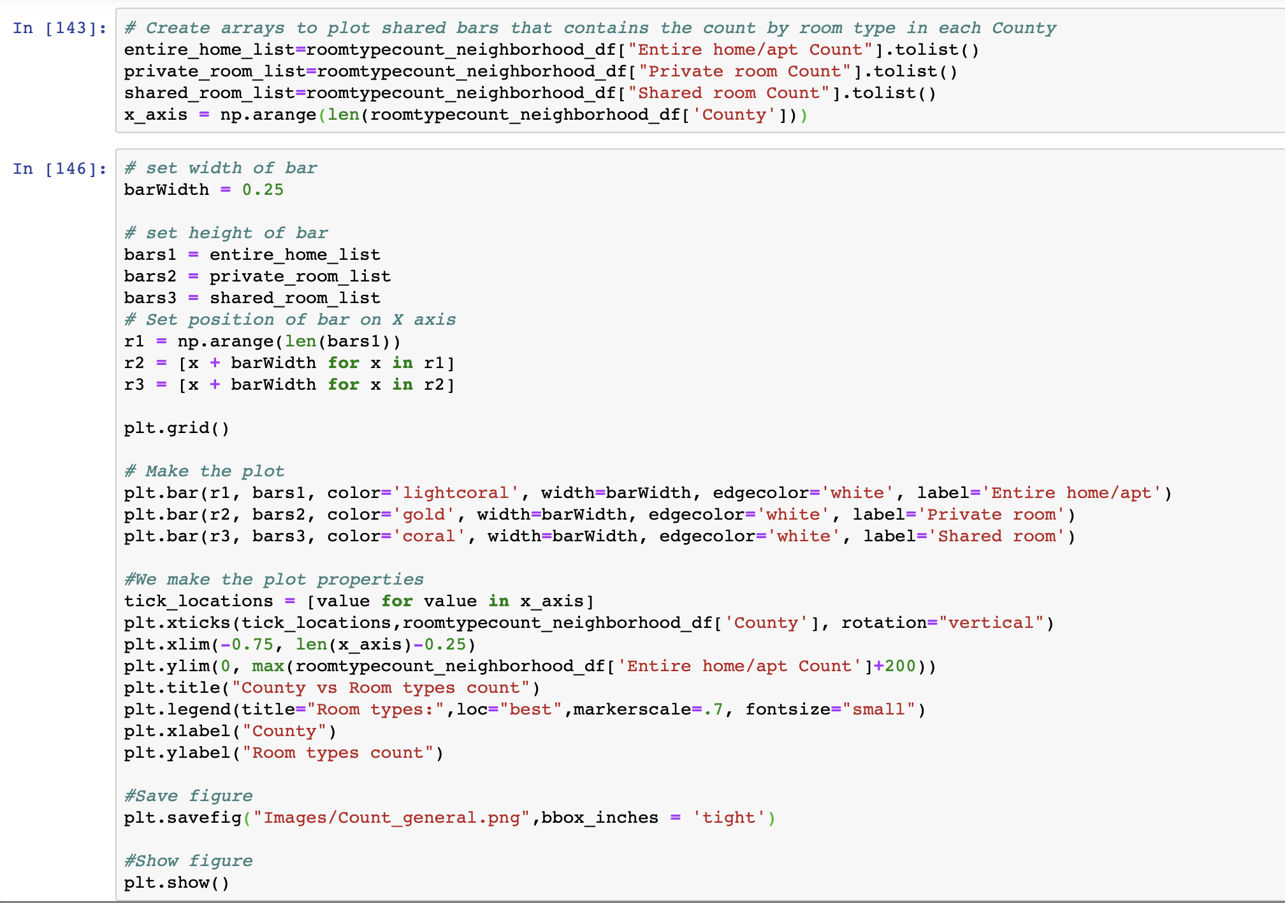
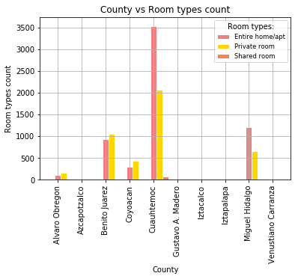
Analyze Room Type Vs Location
Room Type count by Location:

Slide 27
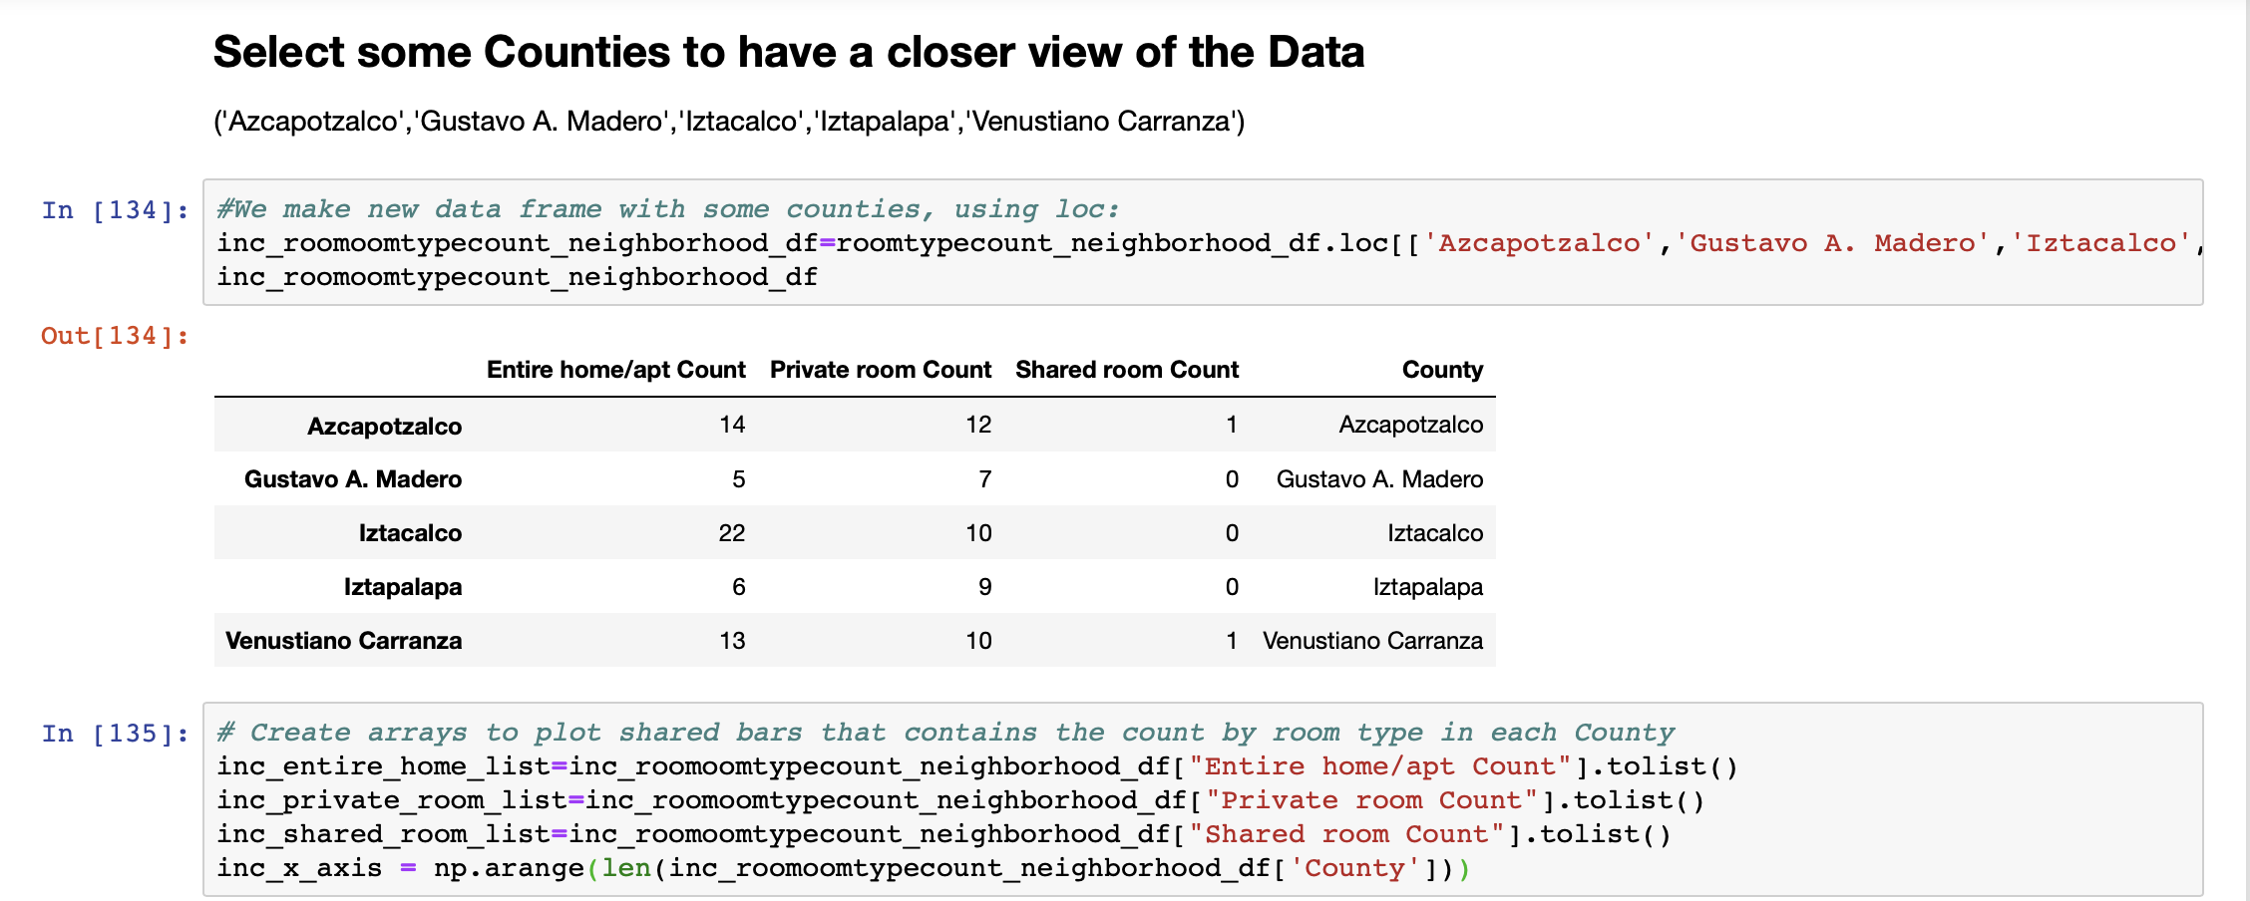
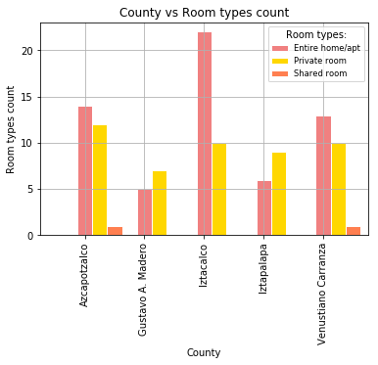
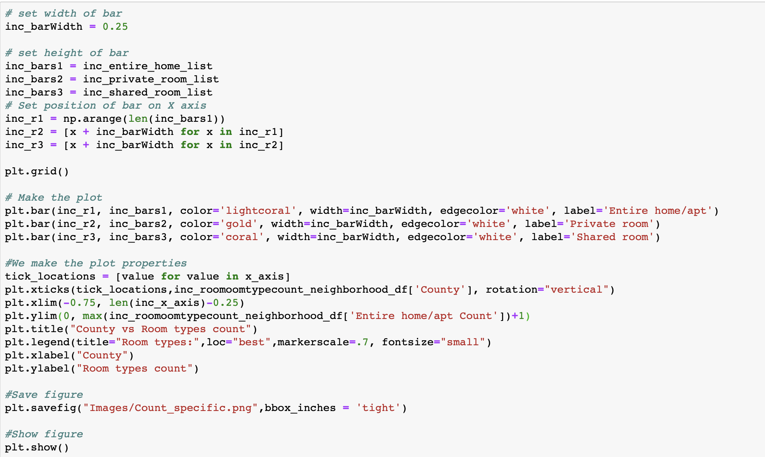
Analyze Room Type Vs Location
Room Type count by Location, but now, have a better visualization of some Counties:

Slide 28
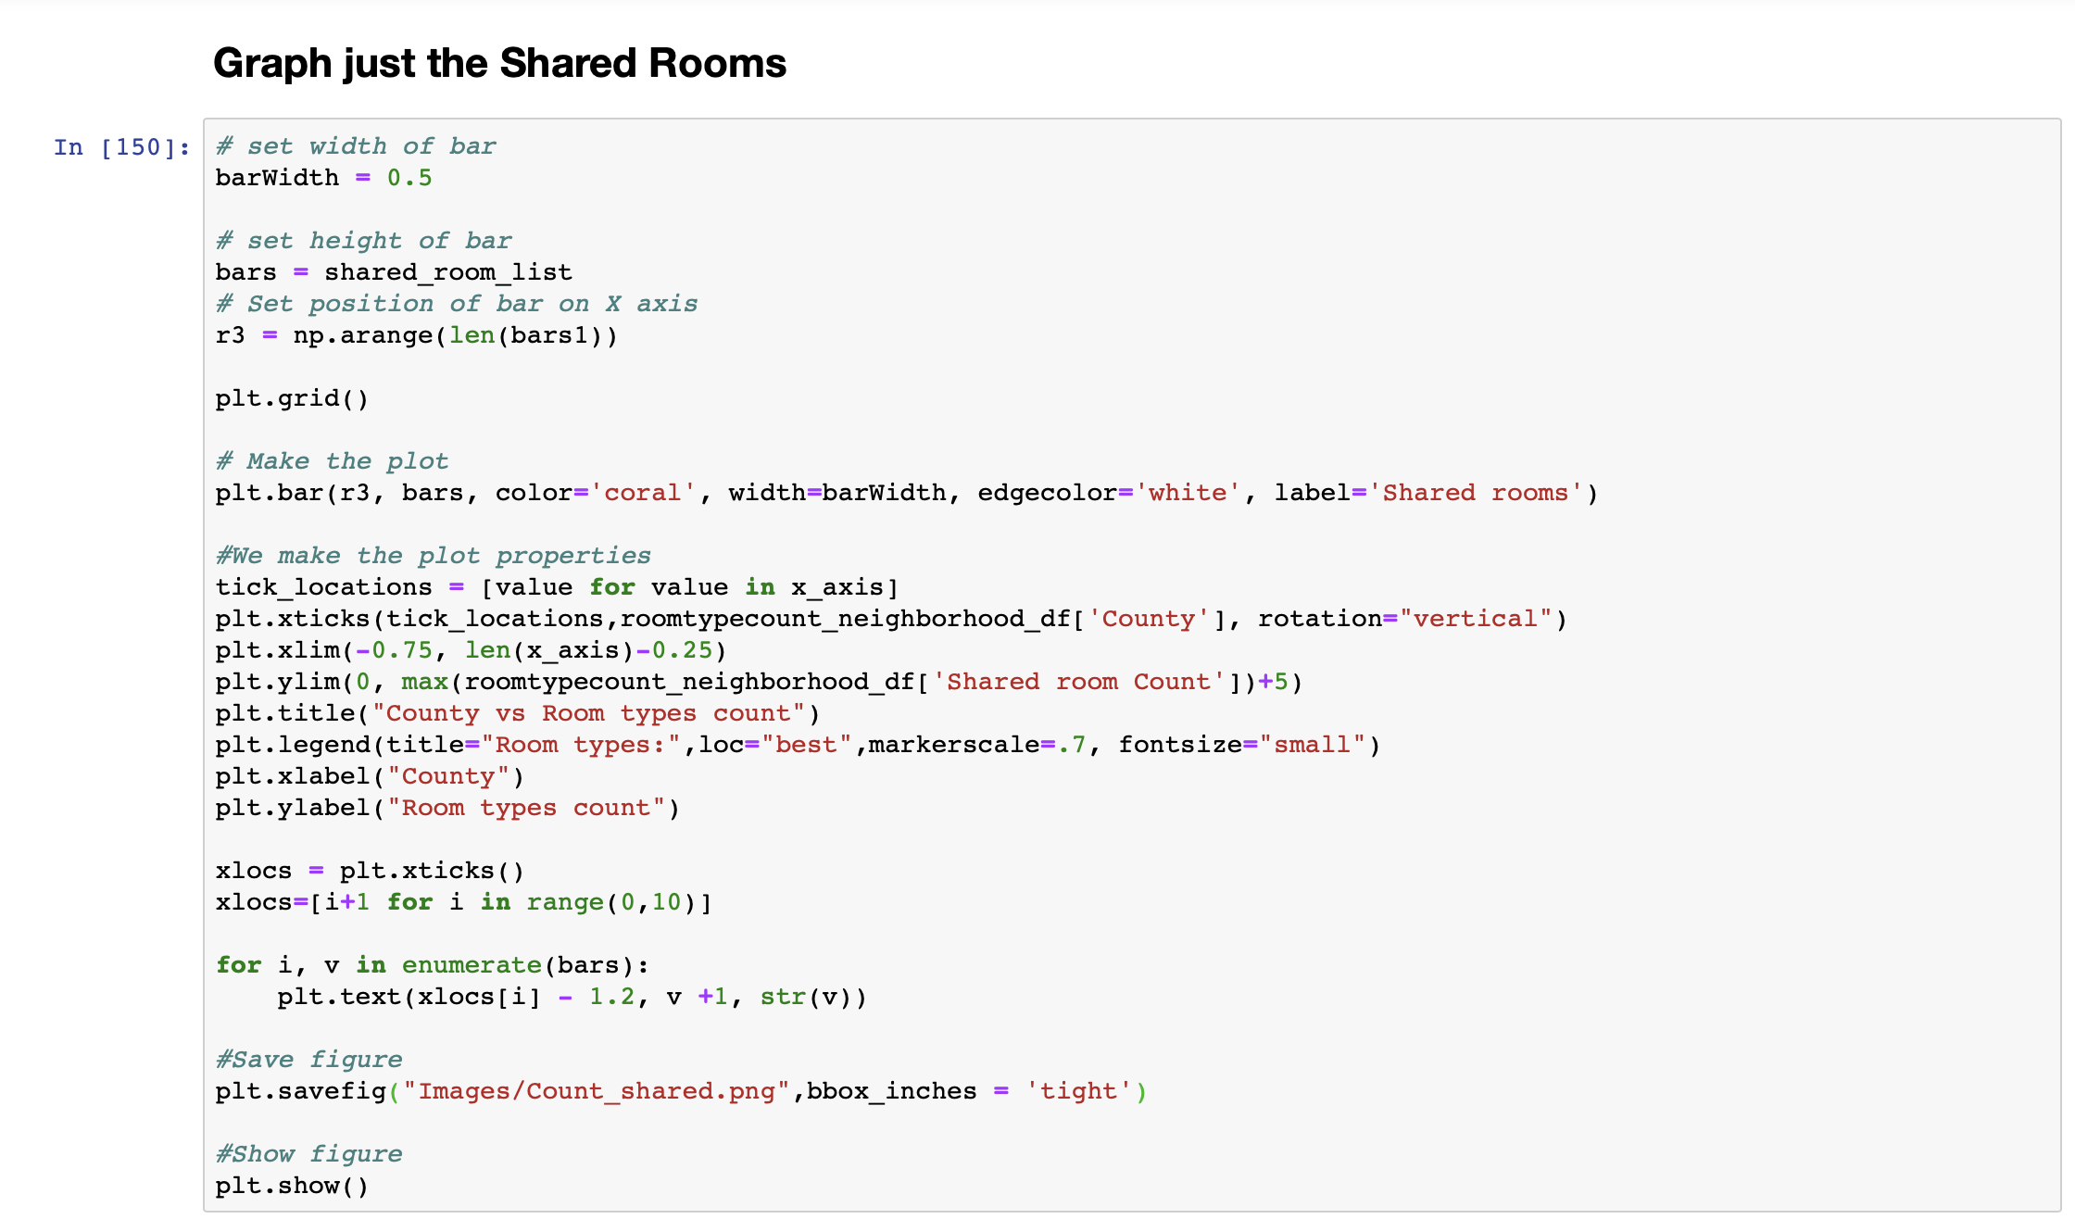
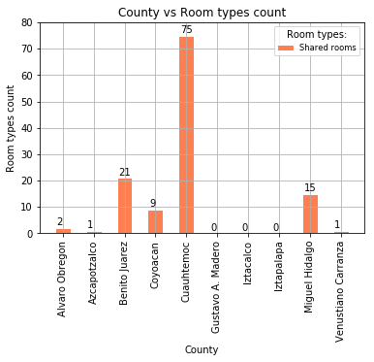
Analyze Room Type Vs Location
Room Type count by Location, but now, just Shared Rooms with values:

Slide 29
Step 8: Acknowledge Limitations
Even though The Hosts “Research Agency” wanted to analyze actual Airbnb utilization to achieve a more accurate answer to our hypothesis, we did not find any information of real reservations only from available properties.

Slide 30
Step 9: Make the Call
Considering the public available dataset of Airbnb of CDMX:
Which is the best neighbourhood to become an Airbnb host?
Does the location / type of room / ratings-comments relate to the price per night and therefore the price of property?
Hypothesis – If location / type of room / ratings-comments are related to the price, then investing to become a host in Airbnb is good choice.
Null Hypothesis - If location / type of room / ratings-comments are not related to the price, then investing to become a host in Airbnb is not a good choice.

